Slide 1
ASSIGNMENT 1
VARUN MADHAV E
ECE-III YEAR

Slide 2
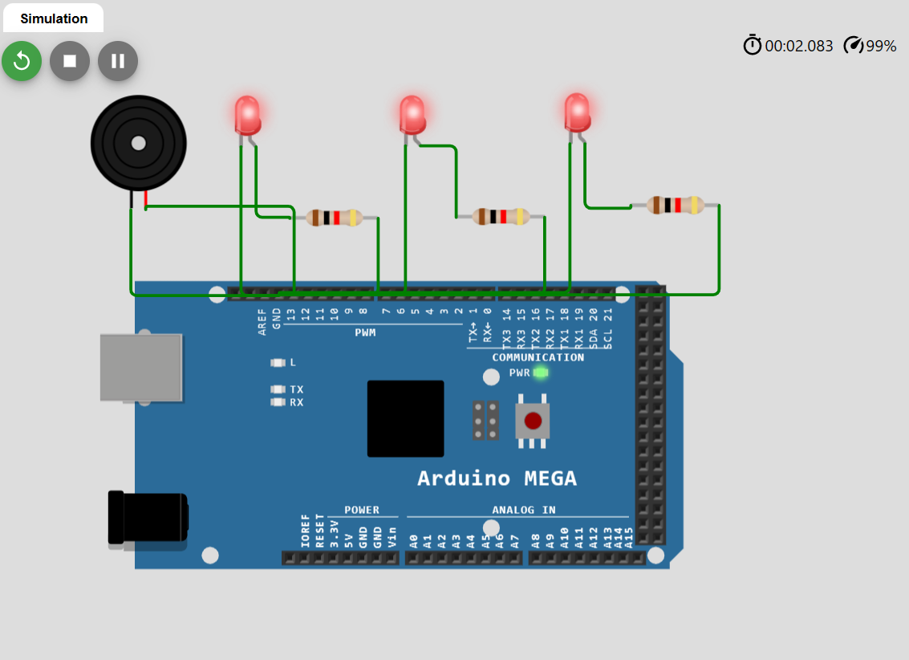
BUILD A SMART HOME IN WOKWI WITH MINIMUM 2 SENSOR, LED, BUZZER

Slide 3
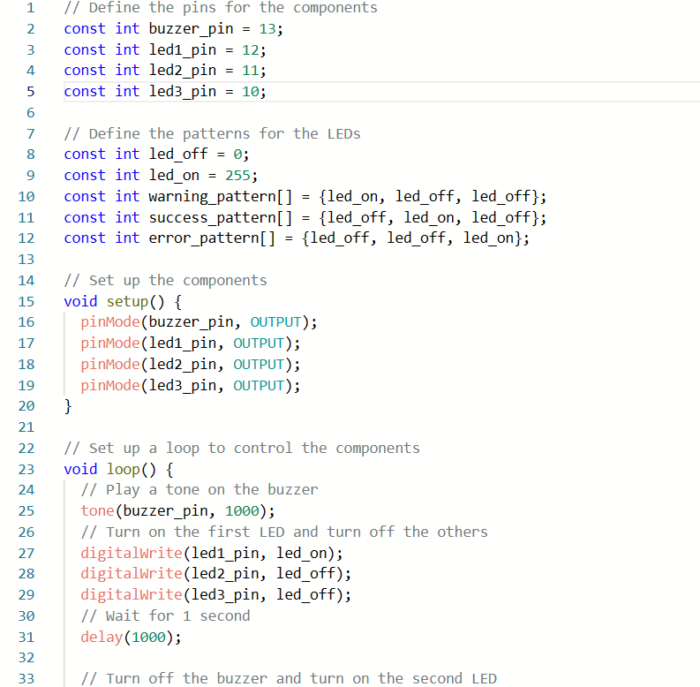

Slide 4
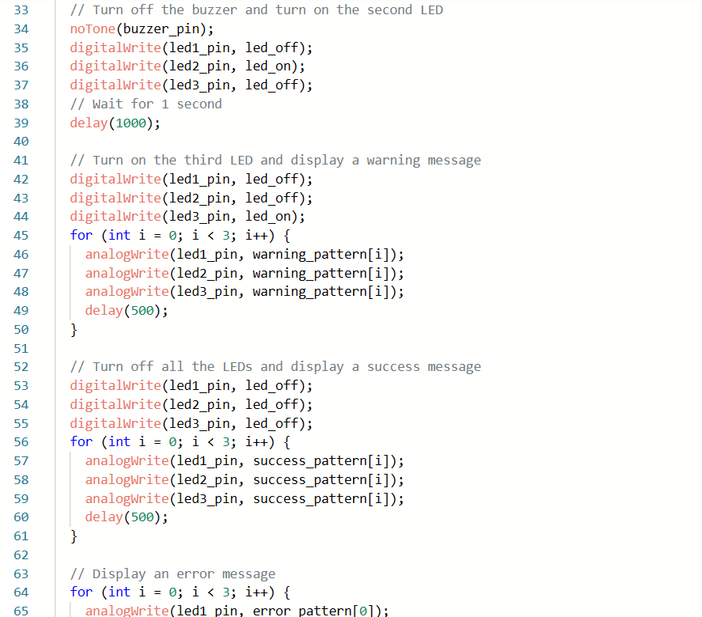

Slide 5
